Slide 1
Assignment -1
-Control Over an Embedded Computing Platform

Slide 2
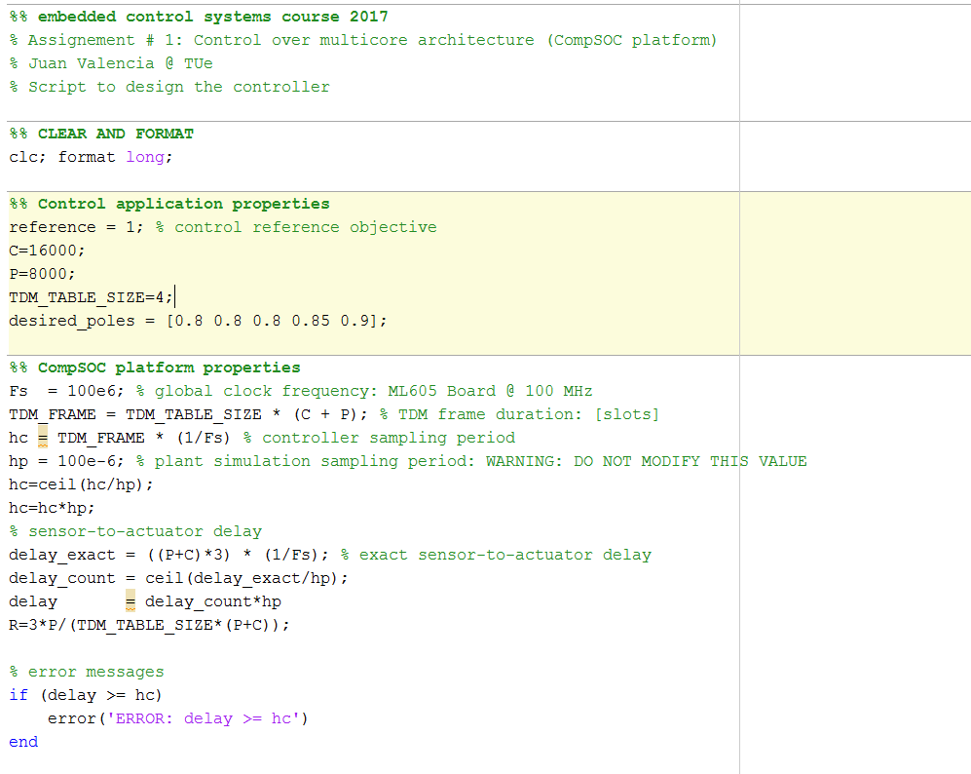
Control Design Script
Design Parameters
Computation of Sensor-actuator Delay
(from design parameters)
Assertion for delay to be strictly less than sample time

Slide 3
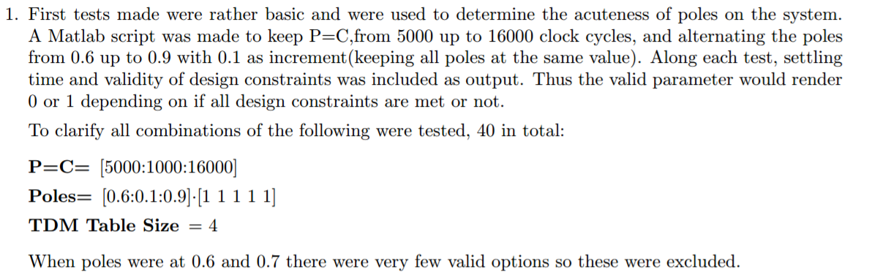
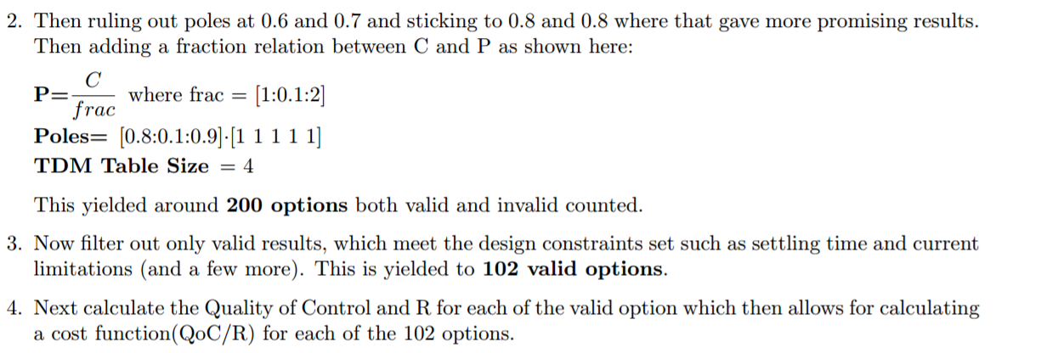
State-Space Exploration (Brute Force- QOC/R)

Slide 4
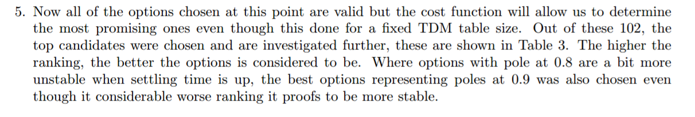
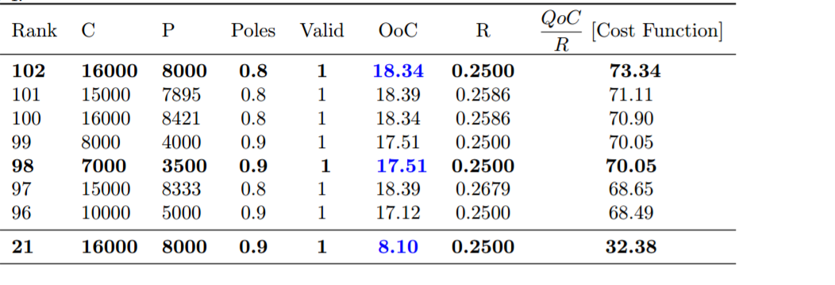
Determining C and P

Slide 5
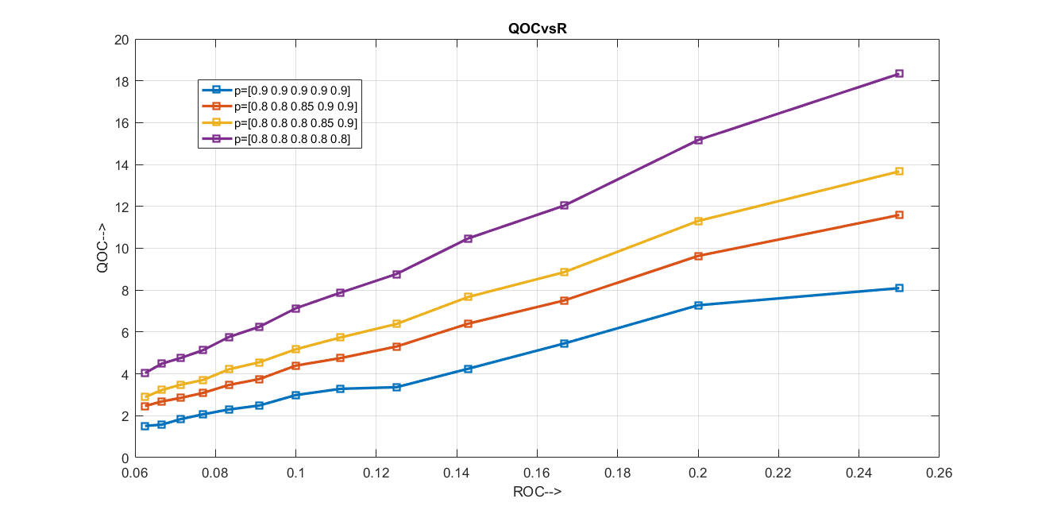
QOC vs R
4 slots -> High usage
7 slots-
Medium Usage
16 slots –
Low usage

Slide 6
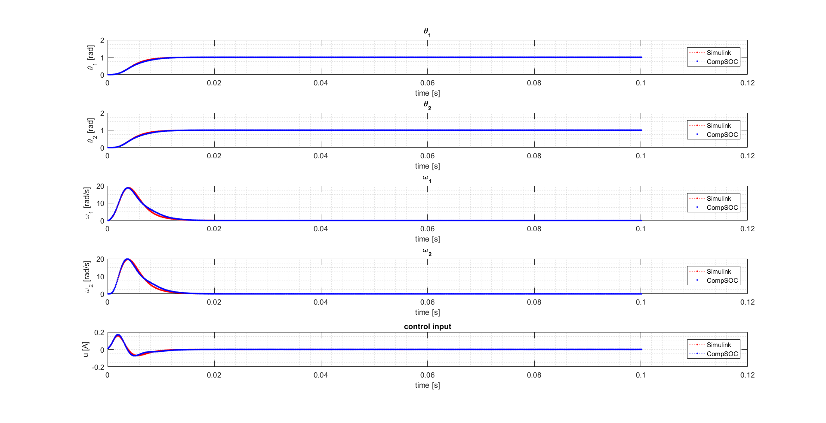
Comparison of Results from Simulation and Platform

